Slide 1


Noida Institute of Engineering and Technology, Greater Noida
Data Link layer
Unit: 2
Computer Networks (ACSE0602)
Ms. Manisha
B.Tech- CS
Department
B Tech 6th Sem

Slide 2

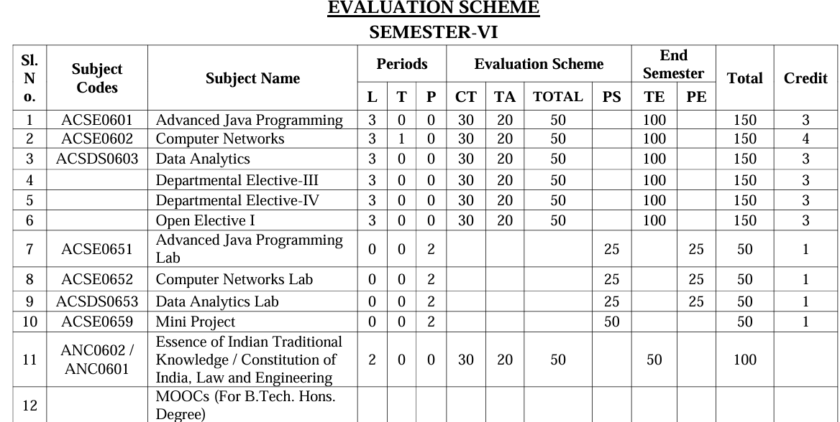


Curriculum

Slide 3
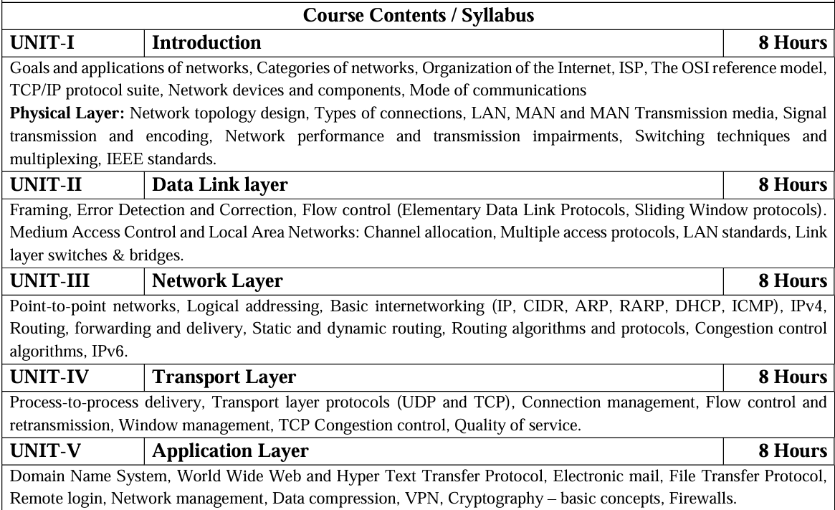
Syllabus

Slide 4
Books
Text books:
Behrouz Forouzan, “Data Communication and Networking” Fourth Edition-2006, Tata McGraw Hill
Andrew Tanenbaum “Computer Networks”, Fifth Edition-2011, Prentice Hall.
William Stallings, “Data and Computer Communication”, Eighth Edition-2008, Pearson.
Reference Books:
Kurose and Ross, “Computer Networking- A Top-Down Approach”, Eighth Edition-2021, Pearson.
Peterson and Davie, “Computer Networks: A Systems Approach”, Fourth Edition-1996, Morgan Kaufmann

Slide 5
Course Objective
The objective of this course is to understand introduction of computer networks with suitable transmission media and different networking devices. Network protocols which are essential for the computer network are need to explain such as data link layer protocols and routing protocols.
A detail explanation of IP addressing , TCP/IP protocols and application layer protocols are covered in this course.

Slide 6
Course Outcome
At the end of the course the student should be able to:
CO 1 Build an understanding of the fundamental concepts and Layered Architecture of computer networking.
CO 2 Understand the basic concepts of link layer properties to detect error and develop the solution for error control and flow control.
CO 3 Design, calculate, and apply subnet masks and addresses to fulfil networking requirements and calculate distance among routers in subnet.
CO 4 Understand the duties of transport layer, Session layer with connection management of TCP protocol.
CO 5 Discuss the different protocols used at application layer.

Slide 7
PO’s
1.Engineering knowledge
2. Problem analysis
3. Design/development of solutions
4. Conduct investigations of complex problems
5. Modern tool usage
6. The engineer and society
7. Environment and sustainability
8. Ethics
9. Individual and team work
10. Communication
11. Project management and finance
12. Life-long learning

Slide 8
CO-PO Mapping
Computer Networks(ACSE0602) |  |  |  |  |  |  |  |  | Year of Study: 2021-22
CO | PO1 | PO2 | PO3 | PO4 | PO5 | PO6 | PO7 | PO8 | PO9 | PO10 | PO11 | PO12
ACSE0602 | 3 | 2 | 2 |  | 2 |  |  |  | 2 |  | 2 | 3
ACSE0602 | 3 | 3 | 2 |  |  |  |  |  |  |  |  | 3
ACSE0602 | 3 | 3 | 3 | 3 | 2 |  |  |  | 2 |  | 2 | 3
ACSE0602 | 3 | 2 | 2 |  | 2 |  |  |  |  |  |  | 3
ACSE0602 | 3 | 3 | 2 |  | 2 | 3 |  | 2 |  |  |  | 3
ACSE0602 | 3 | 2 | 2 |  | 2 | 2 | 2 | 2 |  | 2 | 2 | 3

Slide 9
PSO’s
On successful completion of graduation degree, The computer Science & Engineering graduates will be able to:
PSO1: identify, analyze real world problems and design their ethical solutions using artificial intelligence, robotics, virtual/augmented reality, data analytics, block chain technology, and cloud computing.
PSO2: design and develop the hardware sensor devices and related interfacing software systems for solving complex engineering problems.
PSO 3: understand inter-disciplinary computing techniques and to apply them in the design of advanced computing.
PSO 4: conduct investigation of complex problem with the help of technical, managerial, leadership qualities, and modern engineering tools provided by industry sponsored laboratories.

Slide 10
PSO’s
CO | PSO1 | PSO2 | PSO3 | PSO4
ACSE0602 | 2 | 2 | 2 | 2
ACSE0602 | 2 | 2 | 2 | 2
ACSE0602 | 2 | 2 | 2 | 3
ACSE0602 | 2 | 2 | 2 | 2
ACSE0602 | 2 | 2 | 2 | 2
ACSE0602 | 2 | 2 | 2 | 2

Slide 11
Program Educational Objectives
PEO 1: To have an excellent scientific and engineering breadth so as to comprehend, analyze, design and provide sustainable solutions for real-life problems using state-of-the-art technologies.
PEO 2: To have a successful career in industries, to pursue higher studies or to support entrepreneurial endeavors and to face the global challenges.
PEO 3:To have an effective communication skills, professional attitude, ethical values and a desire to learn specific knowledge in emerging trends, technologies for research, innovation and product development and contribution to society.
PEO 4: To have life-long learning for up-skilling and re-skilling for successful professional career as engineer, scientist, entrepreneur and bureaucrat for betterment of society.

Slide 12
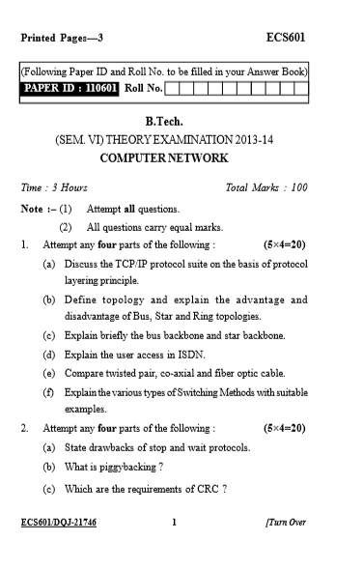
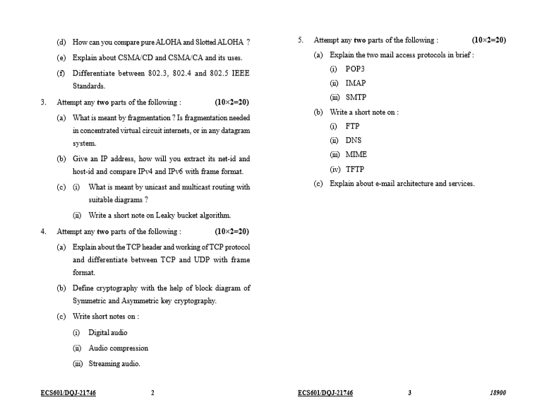
End semester Question paper templates

Slide 13
Prerequisite and Recap
Fundamental of computer
Types of Network and OSI Model, TCP/IP Model
Encoding
Packet switching

Slide 14
Content
Functions of data link layer
Sub layers of data link layer
Project 802
PDU format
MAC frame
IEEE LAN standards
Ethernet
Token Ring
FDDI
DQDB
Data Link Layer Protocols
Multiple Access Protocol
Flow control
Error control

Slide 15
Unit Objective
The objective of this course is to understand the duties of data link layer, medium access protocol like ALOHA, CSMA,TOKEN RING & FDDI. Study the flow conrol and error control methods. Study the IEEE 802 project about network.

Slide 16
Data Link Layer (Introduction)
Data Link Layer is second layer of OSI Layered Model.
Data link layer works between two hosts which are directly connected in some sense.
This direct connection could be point to point or broadcast.
data link layer tends to get more complex when it is dealing with multiple hosts on single collision domain.
Data link layer is responsible for converting data stream to signals bit by bit and to send that over the underlying hardware.
Data link layer picks up data from hardware which are in the form of electrical signals, assembles them in a recognizable frame format, and hands over to upper layer.

Slide 17
Data Link Layer (Introduction)
Data link layer has two sub-layers:
Logical Link Control: It deals with protocols, flow-control, and error control
Media Access Control: MAC sublayer manages the device’s interaction, responsible for addressing frames, and also controls physical media access.

Slide 18
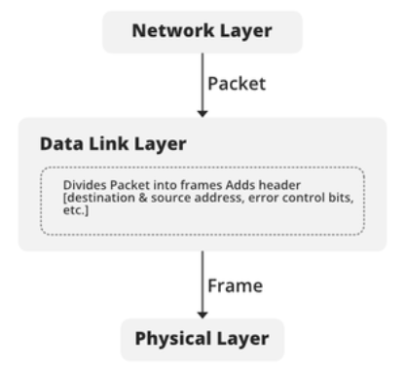
Functionality of Data-link Layer

Slide 19
Data link layer Functions
Framing
Framing in data link layer is a point-to-point connection between the sender and receiver.
The framing is the primary function of the data link layer and it provides a way to transmit data between the connected devices.
Framing uses frames to send or receive data. The data link layer receives packets from the network layer and converts them into frames.
If the frame size is too large, then the packet can be divided into smaller frames. Small frames are more efficient for flow control and error control.
The data link layer needs to pack bits into frames so that each frame is distinguishable from another. The simple act of inserting a letter into an envelope separates one piece of information from another.

Slide 20
Data link layer Functions
The frame is consist of four parts as follows.
Header–The source and destination address is placed into the header part of the frame.
Payload field–It contains the actual message or information that the sender wants to transmit to the destination machine.
Trailer–The trailer comprises error detection and error correction bits.
Flag–It shows the beginning and end of a particular frame

Slide 21
Data link layer Functions
The frame is consist of four parts as follows.
Header–The source and destination address is placed into the header part of the frame.
Payload field–It contains the actual message or information that the sender wants to transmit to the destination machine.
Trailer–The trailer comprises error detection and error correction bits.
Flag–It shows the beginning and end of a particular frame.
In data link layer used two type of framing
Fixed Size Framing
Variable Size Framing
Fixed Size Framing The frame has a fixed size. In fixed-size framing, there is no need for defining the boundaries of the frames to mark the beginning and end of a frame.
For example- This type of framing is used in ATMs, Wide area networks. They use frames of fixed size called cells.

Slide 22
Data link layer Functions
Fixed Size Framing The frame has a fixed size. In fixed-size framing, there is no need for defining the boundaries of the frames to mark the beginning and end of a frame. For example- This type of framing is used in ATMs, Wide area networks. They use frames of fixed size called cells.
Variable Size Framing
In variable size framing, we need a way to define the end of the frame and the beginning of the next frame. This is used in local area networks.
There are two methods to define the frame boundaries, such as length field and end decimetre.
Length field–To determine the length of the field, a length field is used. It is used in Ethernet (1EEE 802.3).
End Delimiter–To identify the size of the frame, a pattern is used as a delimiter. This method is used in the token ring. In short, it is called an ED.

Slide 23
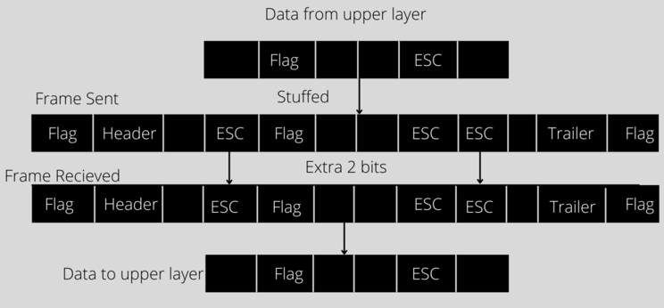
Data link layer Functions
Two methods are used to avoid this situation if the pattern occurs in the message.
Character Oriented Approach ( Byte Stuffing)
Bit Oriented Approach (Bit Stuffing)
Byte stuffing is the process of adding an extra byte when there is a flag or escape character in the text.
The sender sends the frame by adding 3 extra ESC bits and the destination machine received the frame and it removes the extra bits to covert the frame into the same message.

Slide 24
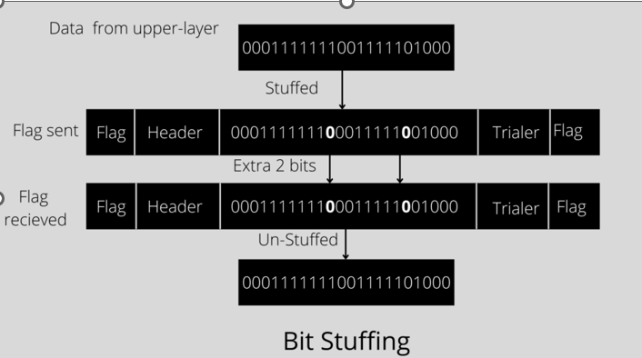
Data link layer Functions
Bit stuffing is done at the sender end and bit removal at the receiver end.
If we have a 0 after five 1s. We still stuff a 0. The receiver will remove the 0. Bit stuffing is also called bit-oriented framing.

Slide 25
Data link layer Functions
Addressing
The data link layer encapsulates the source and destination’s MAC address/ physical address in the header of each frame to ensure node-to-node delivery.
MAC address is the unique hardware address that is assigned to the device while manufacturing.
Error Control
Data can get corrupted due to various reasons like noise, attenuation, etc.
The responsibility of the data link layer, to detect the error in the transmitted data and correct it using error detection and correction techniques respectively.
DLL adds error detection bits into the frame’s header, so that receiver can check received data is correct or not.
It adds reliability to physical layer by adding mechanisms to detect and retransmit damaged or lost frames.

Slide 26
Data link layer Functions
Flow Control
If the receiver’s receiving speed is lower than the sender’s sending speed, then this can lead to an overflow in the receiver’s buffer and some frames may get lost.
The responsibility of DLL to synchronize the sender’s and receiver’s speeds and establish flow control between them.
Access Control
When multiple devices share the same communication channel there is a high probability of collision,
The responsibility of DLL to check which device has control over the channel and CSMA/CD (Carrier Sense Multiple Access/ Collision Detection)and CSMA/CA (Carrier Sense Multiple Access / Collision Avoidance)can be used to avoid collisions and loss of frames in the channel.

Slide 27
Data link layer Functions
Transmitted data can be corrupted during communication. It is likely to be affected by external noise or other physical failures. In such a situation, the input data can’t be the same as the output data. This mismatch is known as “Error.”
There are mainly three types of a bit error that occur in data transmission from the sender to the receiver.
Single bit errors
Multiple bit errors
Burst errors

Slide 28
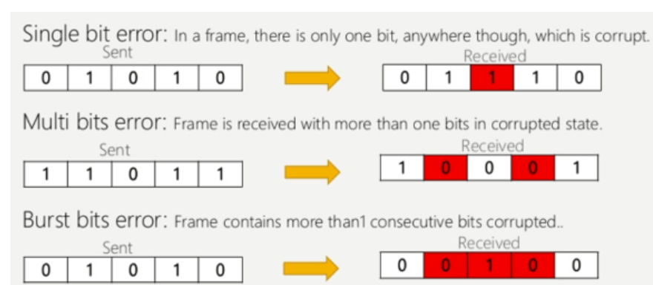
Data link layer Functions

Slide 29
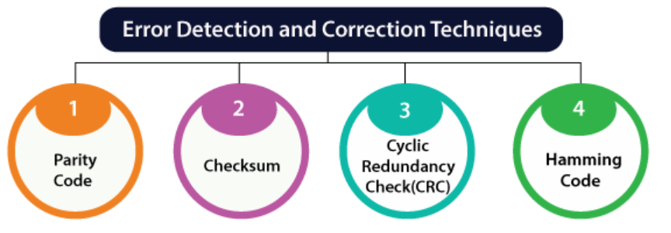
Error Detection Techniques
Error detection and correction code plays an important role in the transmission of data from one source to another.
The noise also gets added into the data when it transmits from one system to another, which causes errors in the received binary data at other systems.
The bits of the data may change(either 0 to 1 or 1 to 0) during transmission.

Slide 30
Error Detection Techniques
Error detection code
The error detection codes are the code used for detecting the error in the received data bitstream.
Error detecting codes encode the message before sending it over the noisy channels.
The encoding scheme is performed in such a way that the decoder at the receiving can find the errors easily in the receiving data with a higher chance of success.

Slide 31
Error Detection Techniques
Error detection code
There are three main techniques for detecting errors in frames:
Parity Check
Checksum
Cyclic Redundancy Check (CRC).

Slide 32
Error Detection Techniques
Parity Check
The parity check is done by adding an extra bit, called parity bit to the data to make a number of 1s either even in case of even parity or odd in case of odd parity.
While creating a frame, the sender counts the number of 1s in it and adds the parity bit in the following way-
In case of even parity: If a number of 1s is even then parity bit value is 0. If the number of 1s is odd then parity bit value is 1.
In case of odd parity: If a number of 1s is odd then parity bit value is 0. If a number of 1s is even then parity bit value is 1.
On receiving a frame, the receiver counts the number of 1s in it. In case of even parity check, if the count of 1s is even, the frame is accepted, otherwise, it is rejected. A similar rule is adopted for odd parity check.
The parity check is suitable for single bit error detection only.

Slide 33
Error Detection Techniques
Checksum
In this error detection scheme, the following procedure is applied
Data is divided into fixed sized frames or segments.
The sender adds the segments using 1’s complement arithmetic to get the sum. It then complements the sum to get the checksum and sends it along with the data frames.
The receiver adds the incoming segments along with the checksum using 1’s complement arithmetic to get the sum and then complements it.
If the result is zero, the received frames are accepted; otherwise, they are discarded.

Slide 34
Error Detection Techniques
Cyclic Redundancy Check (CRC)
Cyclic Redundancy Check (CRC) involves binary division of the data bits being sent by a predetermined divisor agreed upon by the communicating system. The divisor is generated using polynomials.
Here, the sender performs binary division of the data segment by the divisor. It then appends the remainder called CRC bits to the end of the data segment. This makes the resulting data unit exactly divisible by the divisor.
The receiver divides the incoming data unit by the divisor. If there is no remainder, the data unit is assumed to be correct and is accepted. Otherwise, it is understood that the data is corrupted and is therefore rejected.

Slide 35
Error Detection Techniques
Hamming code
Hamming code is used for the set of error-correction codes which may occur when the data is moved from the sender to the receiver.
Hamming code are linear block code.
It is error correcting code that help to detect single data bit error in original data at receiver end.
It is combination of data bits(redundant bits) and parity bits.
Parity bit consist 2 power of n .
To calculate the no. of redundant bits.
2^R = M+R+1
Where R stands for redundant bits and M is the data bits.
we classify the error correction codes into two types as follows:
Single bit error correction
Burst error correction

Slide 36
Flow Control
Flow control is design issue at Data Link Layer. It is a technique that generally observes the proper flow of data from sender to receiver.
Flow control is basically a technique that gives permission to two of stations that are working and processing at different speeds to just communicate with one another.
Flow control in Data Link Layer simply restricts and coordinates number of frames or amount of data sender can send just before it waits for an acknowledgement from receiver.
The receiving device has limited speed and limited memory to store the data. Therefore, the receiving device must be able to inform the sending device to stop the transmission temporarily before the limits are reached.
It requires a buffer, a block of memory for storing the information until they are processed.
Two methods
Stop-and-wait
Unrestricted simplex protocol
Simplex stop and wait protocol
Simplex protocol for noisy channels
Sliding window

Slide 37
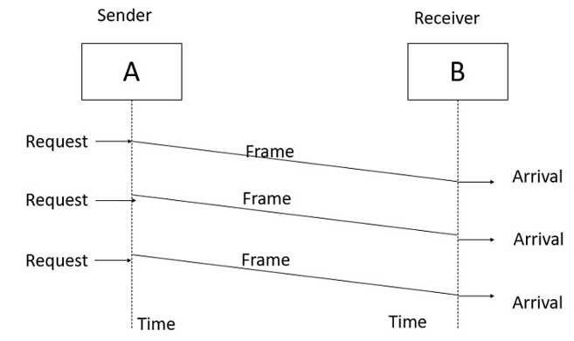
Flow Control

Slide 38
Flow Control
Stop-and-wait
Data is transmitted in one direction only.
No error occurs; the receiver can only process the received information at finite rate.
The transmitter cannot send frames at rate faster than the receiver can process them.
The receiver send some sort of feedback to sender, the process.
Advantage of Stop-and-wait
The Stop-and-wait method is simple as each frame is checked and acknowledged before the next frame is sent.
Disadvantage of Stop-and-wait
How to prevent the sender from flooding the receiver.

Slide 39
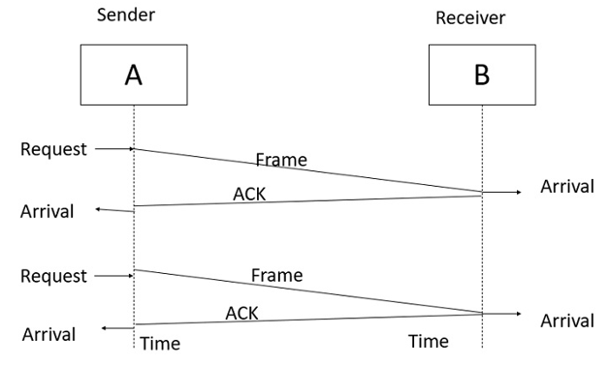
Stop and Wait
The receiver sends the acknowledgement frame back to the sender telling the sender that the last received frame has been processed and passed to the host.
Permission to send the next frame is granted.
The sender after sending the sent frame has to wait for an acknowledge frame from the receiver before sending another frame.
This protocol is called Simplex Stop and wait protocol, the sender sends one frame and waits for feedback from the receiver. When the ACK arrives, the sender sends the next frame.

Slide 40
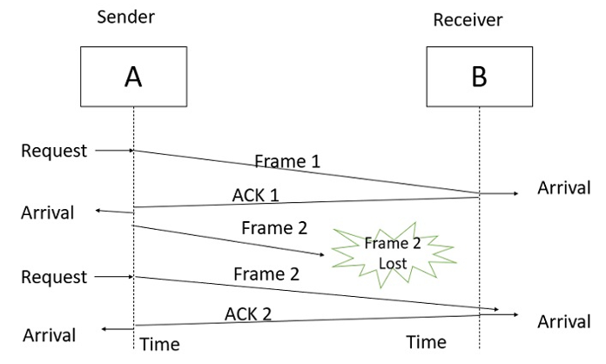
Stop and Wait
Data transfer is only in one direction.
A noisy channel, errors in data frames or acknowledgement frames are expected.
Every frame has a unique sequence number.
After a frame has been transmitted, the timer is started for a finite time. Before the timer expires, if the acknowledgement is not received the frame gets re transmitted. when the acknowledgement gets corrupted or sent data frames gets damaged

Slide 41
Flow Control
Sliding Window
The sliding window is a technique for sending multiple frames at a time.
It controls the data packets between the two devices where reliable and gradual delivery of data frames is needed.
It is also used in TCP (Transmission Control Protocol).
In this technique, each frame has sent from the sequence number. The sequence numbers are used to find the missing data in the receiver end.
The purpose of the sliding window technique is to avoid duplicate data, so it uses the sequence number.
Types of Sliding Window Protocol
Sliding window protocol has two types:
Go-Back-N ARQ
Selective Repeat ARQ

Slide 42
Flow Control
Go-Back-N ARQ
Go-Back-N ARQ protocol is also known as Go-Back-N Automatic Repeat Request.
It is a data link layer protocol that uses a sliding window method.
if any frame is corrupted or lost, all subsequent frames have to be sent again.
The size of the sender window is N in this protocol. For example, Go-Back-8, the size of the sender window, will be 8. The receiver window size is always 1.
If the receiver receives a corrupted frame, it cancels it. The receiver does not accept a corrupted frame. When the timer expires, the sender sends the correct frame again.

Slide 43
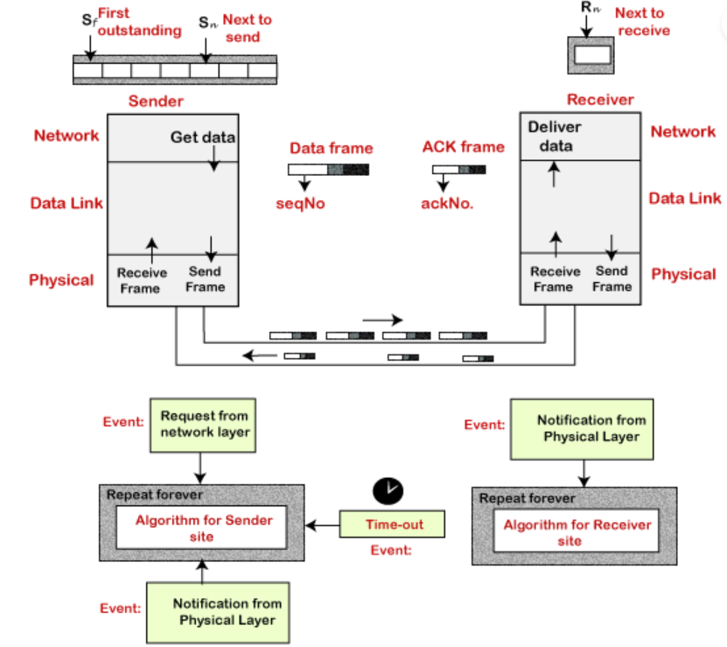
Flow Control

Slide 44
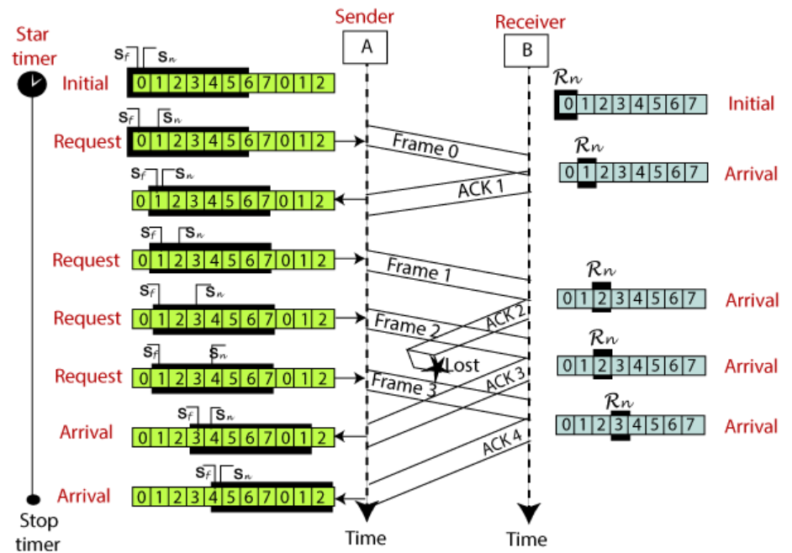
Flow Control

Slide 45
Flow Control
Selective Repeat ARQ
The selective repeat ARQ is one of the Sliding Window Protocol strategies that is used where reliable in-order delivery of the data packets is required.
The selective repeat ARQ is used for noisy channels .
it manages the flow and error control between the sender and the receiver.
In the selective repeat ARQ, we only resend the data frames that are damaged or lost.
If any frame is lost or damaged then the receiver sends a negative acknowledgment (NACK) to the sender and if the frame is correctly received, it sends back an acknowledgment (ACK).
Requirements for Error Control:
It helps us to detect if there is any kind of error in the transmission of data.
Error detection also introduces the concept of ACK and NACK which helps to detect the proper delivery of data frames.
It also helps the sender to detect the damaged or lost data frames so that the sender can re-transmit the frame.

Slide 46
Flow Control
Go-Back-N ARQ | Selective Repeat ARQ
If a frame is corrupted or lost in it,all subsequent frames have to be sent again. | In this, only the frame is sent again, which is corrupted or lost.
If it has a high error rate,it wastes a lot of bandwidth. | There is a loss of low bandwidth.
It is less complex. | It is more complex because it has to do sorting and searching as well. And it also requires more storage.
It does not require sorting. | In this, sorting is done to get the frames in the correct order.
It does not require searching. | The search operation is performed in it.
It is used more. | It is used less because it is more complex.

Slide 47
Flow Control
Go-Back-N ARQ | Selective Repeat ARQ
If a frame is corrupted or lost in it,all subsequent frames have to be sent again. | In this, only the frame is sent again, which is corrupted or lost.
If it has a high error rate,it wastes a lot of bandwidth. | There is a loss of low bandwidth.
It is less complex. | It is more complex because it has to do sorting and searching as well. And it also requires more storage.
It does not require sorting. | In this, sorting is done to get the frames in the correct order.
It does not require searching. | The search operation is performed in it.
It is used more. | It is used less because it is more complex.

Slide 48
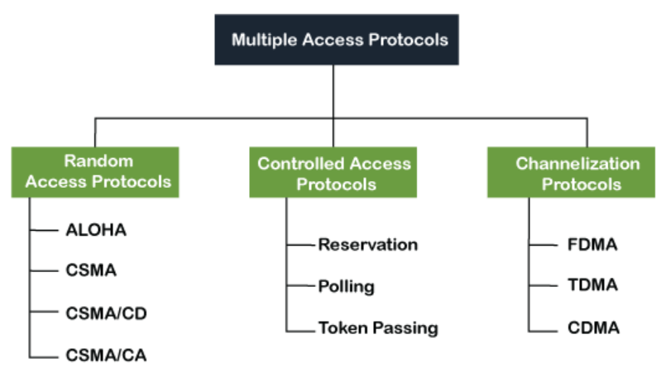
Medium Access Control
The medium access control (MAC) is a sublayer of the data link layer.
It is responsible for flow control and multiplexing for transmission medium.
It controls the transmission of data packets via remotely shared channels. It sends data over the network interface card.
The multiple access protocol is required to reduce the collision and avoid crosstalk between the channels.

Slide 49
Medium Access Control
Random Access Protocol
Random access protocol, one or more stations cannot depend on another station nor any station control another station.
Depending on the channel's state (idle or busy), each station transmits the data frame.
One station sends the data over a channel, there may be a collision or data conflict.
The data frame packets may be lost or changed.
Methods of random-access protocols for broadcasting frames on the channel.
Aloha
CSMA
CSMA/CD
CSMA/CA

Slide 50
Medium Access Control
ALOHA Random Access Protocol
Aloha is a data-link layer multiple access protocol that describes how multiple terminals can access the medium without interference or collision
The term Aloha means "Hello". The Aloha protocol was one of the earliest communication protocols used for computer networking.
It introduced the concept of random access, allowing data packets to be transmitted whenever required, making communication more efficient and flexible.
Aloha Rules
Any station can transmit data to a channel at any time.
It does not require any carrier sensing.
Collision and data frames may be lost during the transmission of data through multiple stations.
Acknowledgment of the frames exists in Aloha. Hence, there is no collision detection.
It requires retransmission of data after some random amount of time.

Slide 51
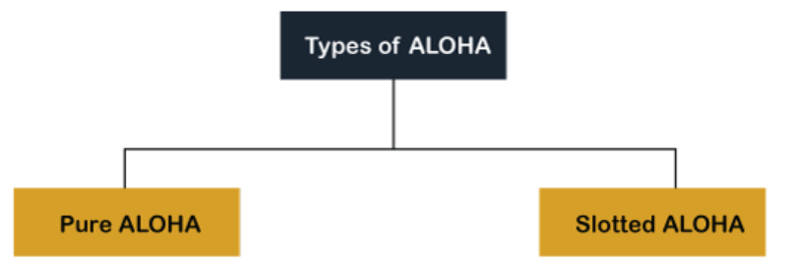
Medium Access Control
Pure Aloha
Each station sends a frame whenever one is available.
when each station transmits data to a channel without checking whether the channel is idle or not, the chances of collision may occur, and the data frame can be lost.
When any station transmits the data frame to a channel, the pure Aloha waits for the receiver's acknowledgment.
If it does not acknowledge the receiver end within the specified time, the station waits for a random amount of time, called the backoff time (Tb).
the station may assume the frame has been lost or destroyed.
it retransmits the frame until all the data are successfully transmitted to the receiver.

Slide 52
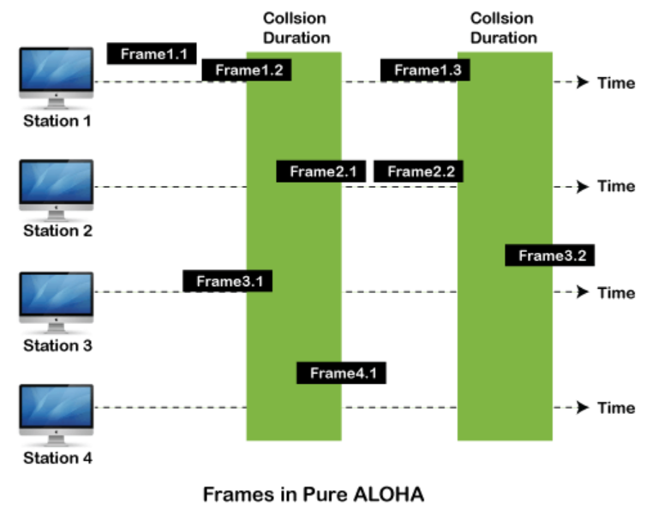
Medium Access Control
The total vulnerable time of pure Aloha is 2 * Tfr.
Maximum throughput occurs when G = 1/ 2 that is 18.4%.
Successful transmission of data frame is S = G * e ^ - 2 G.

Slide 53
Medium Access Control
Slotted Aloha
The slotted Aloha is designed to overcome the pure Aloha's efficiency because pure Aloha has a very high possibility of frame hitting.
the shared channel is divided into a fixed time interval called slots.
if a station wants to send a frame to a shared channel, the frame can only be sent at the beginning of the slot, and only one frame is allowed to be sent to each slot.
the stations are unable to send data to the beginning of the slot, the station will have to wait until the beginning of the slot for the next time.
the possibility of a collision remains when trying to send a frame at the beginning of two or more station time slot.
Maximum throughput occurs in the slotted Aloha when G = 1 that is 37%.
The probability of successfully transmitting the data frame in the slotted Aloha is S = G * e ^ - 2 G.
The total vulnerable time required in slotted Aloha is Tfr

Slide 54
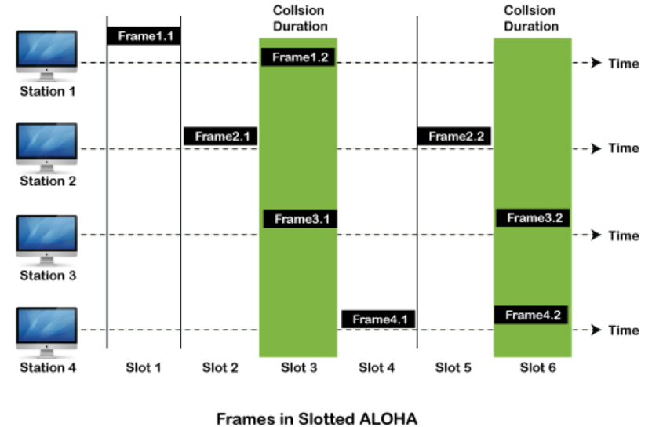
Medium Access Control

Slide 55
Medium Access Control
CSMA (Carrier Sense Multiple Access)
It is a carrier sense multiple access based on media access protocol to sense the traffic on a channel (idle or busy) before transmitting the data.
It means that if the channel is idle, the station can send data to the channel.
it must wait until the channel becomes idle. Hence, it reduces the chances of a collision on a transmission medium.

Slide 56
Medium Access Control
CSMA access modes-
1-persistent: The node senses the channel, if idle it sends the data, otherwise it continuously keeps on checking the medium for being idle and transmits unconditionally(with 1 probability) as soon as the channel gets idle.
Non-Persistent: The node senses the channel, if idle it sends the data, otherwise it checks the medium after a random amount of time (not continuously) and transmits when found idle.
P-persistent: The node senses the medium, if idle it sends the data with p probability. If the data is not transmitted ((1-p) probability) then it waits for some time and checks the medium again, now if it is found idle then it send with p probability. This repeat continues until the frame is sent. It is used in Wifi and packet radio systems.
O-persistent: Superiority of nodes is decided beforehand and transmission occurs in that order. If the medium is idle, node waits for its time slot to send data.

Slide 57
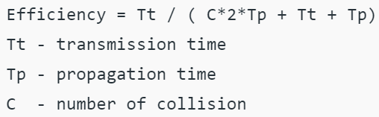
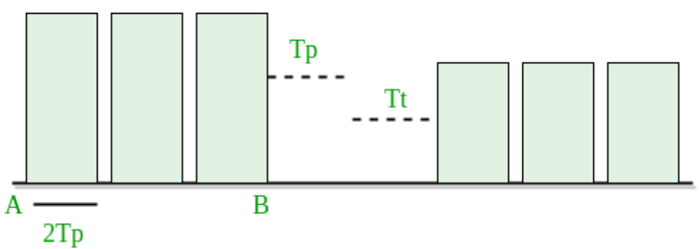
Medium Access Control
Carrier sense multiple access with collision detection (CSMA/CD)
The CSMA method does not tell us what to do in case there is a collision.
Carrier sense multiple access with collision detection (CSMA/CD) adds to the CSMA algorithm to deal with the collision.
CSMA/CD, the size of a frame must be large enough so that collision can be detected by the sender while sending the frame.
The frame transmission delay must be at least two times the maximum propagation delay.
the worst-case to be of n contention slots.

Slide 58
Medium Access Control
This method was developed to decrease the chances of collisions when two or more stations start sending their signals over the data link layer. Carrier Sense multiple access requires that each station first check the state of the medium before sending.
It is used in Wireless LAN.
It employs an algorithm to wait for a random period if the medium is busy, reducing the likelihood of simultaneous transmissions.
Three types of strategies:
Interframe Space (IFS): When a station finds the channel busy it senses the channel again, when the station finds a channel to be idle it waits for a period of time called IFS time. IFS can also be used to define the priority of a station or a frame. Higher the IFS lower is the priority.
Contention Window: It is the amount of time divided into slots. A station that is ready to send frames chooses a random number of slots as wait time.
Acknowledgments: The positive acknowledgments and time-out timer can help guarantee a successful transmission of the frame.
CSMA/CA – Carrier sense multiple access with collision avoidance.

Slide 59
Medium Access Control
CSMA/CD involves the following features:
Carrier sense: Before transmitting data, a device listens to the network to check if the transmission medium is free. If the medium is busy, the device waits until it becomes free before transmitting data.
Multiple Access: In a CSMA/CD network, multiple devices share the same transmission medium. Each device has equal access to the medium, and any device can transmit data when the medium is free.
Collision detection: If two or more devices transmit data simultaneously, a collision occurs. When a device detects a collision, it immediately stops transmitting and sends a jam signal to inform all other devices on the network of the collision. The devices then wait for a random time before attempting to transmit again, to reduce the chances of another collision.
Backoff algorithm: In CSMA/CD, a backoff algorithm is used to determine when a device can retransmit data after a collision. The algorithm uses a random delay before a device retransmits data, to reduce the likelihood of another collision occurring.
Minimum frame size: CSMA/CD requires a minimum frame size to ensure that all devices have enough time to detect a collision before the transmission ends. If a frame is too short, a device may not detect a collision and continue transmitting, leading to data corruption on the network.

Slide 60
Comparisonof various protocols:
Medium Access Control
Protocol | Transmission behavior | Collision detection method | Efficiency | Use cases
Pure ALOHA | Sends frames immediately | No collision detection | Low | Low-traffic networks
Slotted ALOHA | Sends frames at specific time slots | No collision detection | Better than pure ALOHA | Low-traffic networks
CSMA/CD | Monitors medium after sending a frame, retransmits if necessary | Collision detection by monitoring transmissions | High | Wired networks with moderate to high traffic
CSMA/CA | Monitors medium while transmitting, adjusts behavior to avoid collisions | Collision avoidance through random backoff time intervals | High | Wireless networks with moderate to high traffic and high error rates

Slide 61
Medium Access Control
Controlled Access Protocols
In controlled access, the stations seek information from one another to find which station has the right to send. It allows only one node to send at a time, to avoid the collision of messages on a shared medium. The three controlled-access methods are:
Reservation
Polling
Token Passing
Reservation
In the reservation method, a station needs to make a reservation before sending data.
The timeline has two kinds of periods:
Reservation interval of fixed time length
Data transmission period of variable frames.

Slide 62
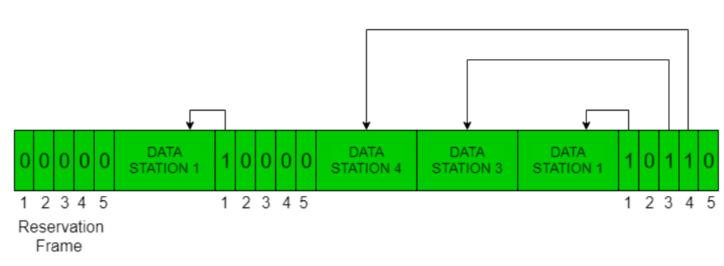
Medium Access Control
The reservation interval is divided into M slots, and each station has one slot.
Suppose if station 1 has a frame to send, it transmits 1 bit during the slot 1. No other station is allowed to transmit during this slot.
In general, i ^{th} station may announce that it has a frame to send by inserting a 1 bit into i ^{th} slot. After all N slots have been checked, each station knows which stations wish to transmit.
The stations which have reserved their slots transfer their frames in that order.
After data transmission period, next reservation interval begins.
Since everyone agrees on who goes next, there will never be any collisions.
a situation with five stations and a five-slot reservation frame. In the first interval, only stations 1, 3, and 4 have made reservations. In the second interval, only station 1 has made a reservation

Slide 63
Medium Access Control
Polling
Polling process is similar to the roll-call performed in class. Just like the teacher, a controller sends a message to each node in turn.
In this, one acts as a primary station(controller) and the others are secondary stations. All data exchanges must be made through the controller.
The message sent by the controller contains the address of the node being selected for granting access.
Although all nodes receive the message the addressed one responds to it and sends data if any. If there is no data, usually a “poll reject”(NAK) message is sent back.
Problems include high overhead of the polling messages and high dependence on the reliability of the controller.

Slide 64
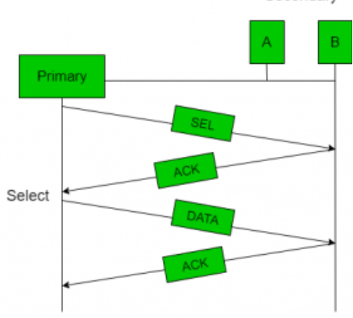
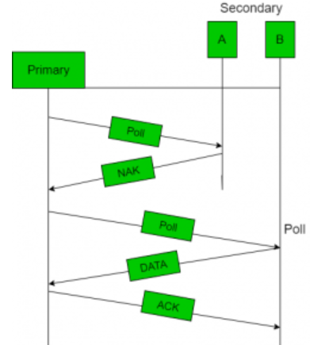
Medium Access Control

Slide 65
Medium Access Control
Token Passing
In token passing scheme, the stations are connected logically to each other in form of ring and access to stations is governed by tokens.
A token is a special bit pattern or a small message, which circulate from one station to the next in some predefined order.
In Token ring, token is passed from one station to another adjacent station in the ring whereas incase of Token bus, each station uses the bus to send the token to the next station in some predefined order.
In both cases, token represents permission to send. If a station has a frame queued for transmission when it receives the token, it can send that frame before it passes the token to the next station. If it has no queued frame, it passes the token simply.
After sending a frame, each station must wait for all N stations (including itself) to send the token to their neighbors and the other N – 1 stations to send a frame, if they have one.

Slide 66
Medium Access Control
Token Passing
In token passing scheme, the stations are connected logically to each other in form of ring and access to stations is governed by tokens.
A token is a special bit pattern or a small message, which circulate from one station to the next in some predefined order.
In Token ring, token is passed from one station to another adjacent station in the ring whereas incase of Token bus, each station uses the bus to send the token to the next station in some predefined order.
In both cases, token represents permission to send. If a station has a frame queued for transmission when it receives the token, it can send that frame before it passes the token to the next station. If it has no queued frame, it passes the token simply.
After sending a frame, each station must wait for all N stations (including itself) to send the token to their neighbors and the other N – 1 stations to send a frame, if they have one.

Slide 67
Medium Access Control
Channelization
Channelization is the process by which we coordinate the transmission of data in non-dedicated channels to prevent collision and crosstalk, and channelization protocols are the MAC protocols we employ to coordinate this transmission.
Channels are communication resources we assign to a user to establish communication with other users in the network.
These resources include frequency, time, code, space, bandwidth, and so on.
Each channelization protocol based on the kind of channel resources we employ for channelization. These protocols are:
Frequency division multiple access (FDMA)
Time division multiple access (TDMA)
Code division multiple access (CDMA)
Space division multiple access (SDMA)
Orthogonal Frequency division multiple access (OFDMA)

Slide 68
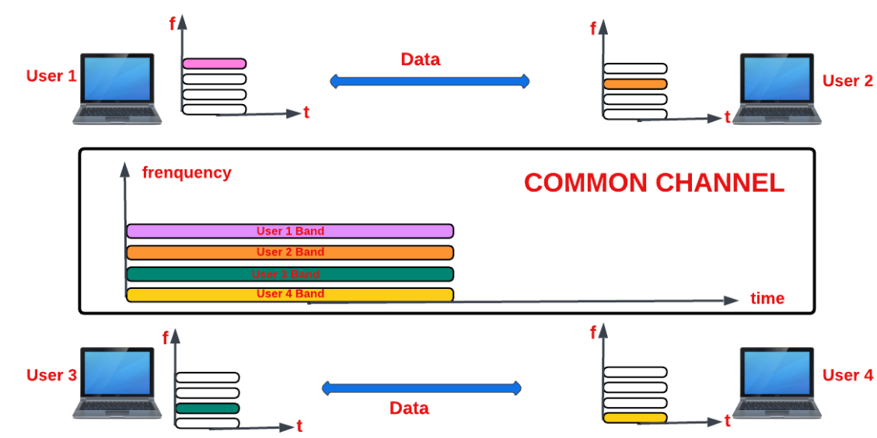
Medium Access Control
Frequency Division Multiple Access (FDMA) Protocol
The FDMA protocol by utilizing the channel resource of frequency. By dividing the channel’s bandwidth into non-overlapping frequency bands or slices, we allocate each user a distinct band for exclusive transmission and reception.
This enables the concurrent operation of multiple users within a single communication channel. To mitigate interference and crosstalk during data transmission, we equip each user with a customized bandpass filter complemented by a small guard band.

Slide 69
Medium Access Control
The FDMA protocol does come with two significant limitations:
the design of high-performing hardware filters proves to be a challenging task
despite the inclusion of guard bands, FDMA remains susceptible to crosstalk, potentially leading to interference and transmission disruptions.
Frequency Allocation Schemes in FDMA Protocols
Regarding frequency slot assignment within the FDMA protocol, we employ two common methods, which are:
Fixed assignment multiple access (FAMA)
Demand assignment multiple access (DAMA)
We use FAMA to allocate frequency slots to users whether they utilize it or not, ensuring a fixed allocation scheme.
DAMA to assign frequency slots to users only upon their explicit request, offering a more dynamic and efficient resource allocation approach.

Slide 70
Medium Access Control
The FDMA protocol does come with two significant limitations:
the design of high-performing hardware filters proves to be a challenging task
despite the inclusion of guard bands, FDMA remains susceptible to crosstalk, potentially leading to interference and transmission disruptions.
Frequency Allocation Schemes in FDMA Protocols
Regarding frequency slot assignment within the FDMA protocol, we employ two common methods, which are:
Fixed assignment multiple access (FAMA)
Demand assignment multiple access (DAMA)
We use FAMA to allocate frequency slots to users whether they utilize it or not, ensuring a fixed allocation scheme.
DAMA to assign frequency slots to users only upon their explicit request, offering a more dynamic and efficient resource allocation approach.

Slide 71
Medium Access Control
Time Division Multiple Access (TDMA) Protocol
The TDMA protocol, we divide each user’s signal into a different time slot and assign each time slot to a different user.
This technique enables numerous users to share and use the same frequency channel.
A 2G cellular system, is one significant application where we have used the TDMA protocol.
Synchronizing the various users of the channel is one of the biggest challenges. when utilizing the TDMA protocol.
To achieve synchronization, we ensure each user knows their respective slots’ start and endpoints.
when utilizing TDMA systems is the potential for causing interference at a frequency that closely adjoins another user’s active time slot.
The FDMA protocol, there are two methods we use to administer time slots to users:
Fixed time division multiple access (F-TDMA)
Dynamic time division multiple access (D-TDMA)

Slide 72
Medium Access Control
Code Division Multiple Access (CDMA) Protocol
The CDMA protocol, we allow multiple users to simultaneously transmit their data signals over the entire bandwidth of the common channel by assigning unique spreading codes to each user.
This technique helps us utilize the channel more effectively.
In CDMA, we employ both time and frequency for users to send their data over the entire bandwidth of the channel with a unique spreading code allotted to the user. Only receivers having this unique code can receive the sent messages.

Slide 73
Local Area Networks
A Local Area Network (LAN) is a private network that connects computers and devices within a limited area like a residence, an office, a building or a campus. On a small scale,
LANs are used to connect personal computers to printers.
LANs can also extend to a few kilometers when used by companies, where a large number of computers share a variety of resources like hardware (e.g. printers, scanners, audiovisual devices etc), software (e.g. application programs) and data.
Features of LAN are
Network size is limited to a small geographical area, presently to a few kilometers.
Data transfer rate is generally high. They range from 100 Mbps to 1000 Mbps.
In general, a LAN uses only one type of transmission medium, commonly category 5 coaxial cables.
A LAN is distinguished from other networks by their topologies. The common topologies are bus, ring, mesh, and star.
The number of computers connected to a LAN is usually restricted. In other words, LANs are limitedly scalable.
IEEE 802.3 or Ethernet is the most common LAN. They use a wired medium in conjuncture with a switch or a hub. Originally, coaxial cables were used for communications. But now twisted pair cables and fiber optic cables are also used. Ethernet’s speed has increased from 2.9 Mbps to 400 Gbps.

Slide 74
Local Area Networks
Types of Computer Networks also, like :
PAN (Personal Area Network)
SAN (Storage Area Network)
EPN (Enterprise Private Network)
VPN (Virtual Private Network)
PAN is a personal area network having an interconnection of personal technology devices to communicate over a short distance. It covers only less than 10 meters or 33 feet of area.
LAN or Local Area Network connects network devices in such a way that personal computers and workstations can share data, tools, and programs.
MAN or Metropolitan area Network covers a larger area than that covered by a LAN and a smaller area as compared to WAN. MAN has a range of 5-50km.
WAN or Wide Area Network is a computer network that extends over a large geographical area, although it might be confined within the bounds of a state or country. WAN has a range of above 50 km.

Slide 75
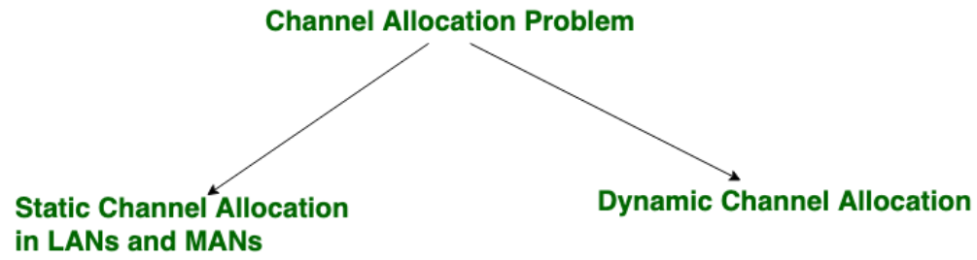
Channel allocation
Channel allocation is a process in which a single channel is divided and allotted to multiple users in order to carry user specific tasks.
there are N number of users and channel is divided into N equal-sized sub channels, Each user is assigned one portion.
Multiplexing can be used as it is a simple and efficient channel bandwidth allocating technique.
Channel allocation problem can be solved by two schemes: Static Channel Allocation in LANs and MANs, and Dynamic Channel Allocation.

Slide 76
Channel allocation
Static Channel Allocation in LANs and MANs: It is the classical or traditional approach of allocating a single channel among multiple competing users using Frequency Division Multiplexing (FDM).
there are N users, the frequency channel is divided into N equal sized portions (bandwidth), each user being assigned one portion.
Dynamic Channel Allocation:
In dynamic channel allocation scheme, frequency bands are not permanently assigned to the users. Instead channels are allotted to users dynamically as needed, from a central pool. The allocation is done considering a number of parameters so that transmission interference is minimized.
Dynamic channel allocation is further divided into:
Centralized Allocation
Distributed Allocation

Slide 77
Link layer switches & bridges
Network switching is the process of forwarding data frames or packets from one port to another leading to data transmission from source to destination.
Data link layer is the second layer of the Open System Interconnections (OSI) model whose function is to divide the stream of bits from physical layer into data frames and transmit the frames according to switching requirements.
Switching in data link layer is done by network devices called bridges.

Slide 78
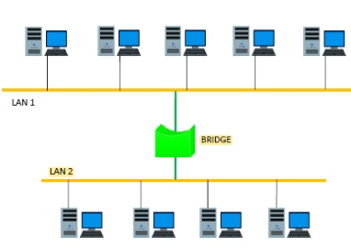
Link layer switches & bridges
Bridges
A data link layer bridge connects multiple LANs (local area networks) together to form a larger LAN. This process of aggregating networks is called network bridging. A bridge connects the different components so that they appear as parts of a single network.

Slide 79
Link layer switches & bridges
Switching by Bridges
When a data frame arrives at a particular port of a bridge, the bridge examines the frame’s data link address, or more specifically, the MAC address. If the destination address as well as the required switching is valid, the bridge sends the frame to the destined port. Otherwise, the frame is discarded.
The bridge is not responsible for end to end data transfer. It is concerned with transmitting the data frame from one hop to the next. Hence, they do not examine the payload field of the frame. Due to this, they can help in switching any kind of packets from the network layer above.
Bridges also connect virtual LANs (VLANs) to make a larger VLAN.
If any segment of the bridged network is wireless, a wireless bridge is used to perform the switching.
There are three main ways for bridging −
simple bridging
multi-port bridging
learning or transparent bridging

Slide 80
A pure ALOHA network transmits 200-bit frames on a shared channel of 200 kbps. What is the throughput if the system (all stations together) produces
a. 1000 frames per second b. 500 frames per second
c. 250 frames per second.
Questions
Solution
The frame transmission time is 200/200 kbps or 1 ms.
a. If the system creates 1000 frames per second, this is 1 frame per millisecond. The load is 1. In this case S = G× e^{−2 G} or S = 0.135 (13.5 percent). This means that the throughput is 1000 × 0.135 = 135 frames. Only 135 frames out of 1000 will probably survive.

Slide 81
Questions
A pure ALOHA network transmits 200-bit frames on a shared channel of 200 kbps. What is the requirement to make this frame collision-free?
Solution
Average frame transmission time T_{fr} is 200 bits/200 kbps or 1 ms. The vulnerable time is 2 × 1 ms = 2 ms. This means no station should send later than 1 ms before this station starts transmission and no station should start sending during the one 1-ms period that this station is sending.

Slide 82
Solution cont…
b. If the system creates 500 frames per second, this is (1/2) frame per millisecond. The load is (1/2). In this case S = G × e ^{−2G} or S = 0.184 (18.4 percent). This means that the throughput is 500 × 0.184 = 92 and that only 92 frames out of 500 will probably survive. Note that this is the maximum throughput case, percentagewise.
c. If the system creates 250 frames per second, this is (1/4) frame per millisecond. The load is (1/4). In this case S = G × e −^{2G} or S = 0.152 (15.2 percent). This means that the throughput is 250 × 0.152 = 38. Only 38 frames out of 250 will probably survive.

Slide 83
Questions
A slotted ALOHA network transmits 200-bit frames on a shared channel of 200 kbps. What is the throughput if the system (all stations together) produces
a. 1000 frames per second b. 500 frames per second
c. 250 frames per second.
Solution
The frame transmission time is 200/200 kbps or 1 ms.
a. If the system creates 1000 frames per second, this is 1 frame per millisecond. The load is 1. In this case S = G× e^{−G} or S = 0.368 (36.8 percent). This means that the throughput is 1000 × 0.0368 = 368 frames. Only 386 frames out of 1000 will probably survive.

Slide 84
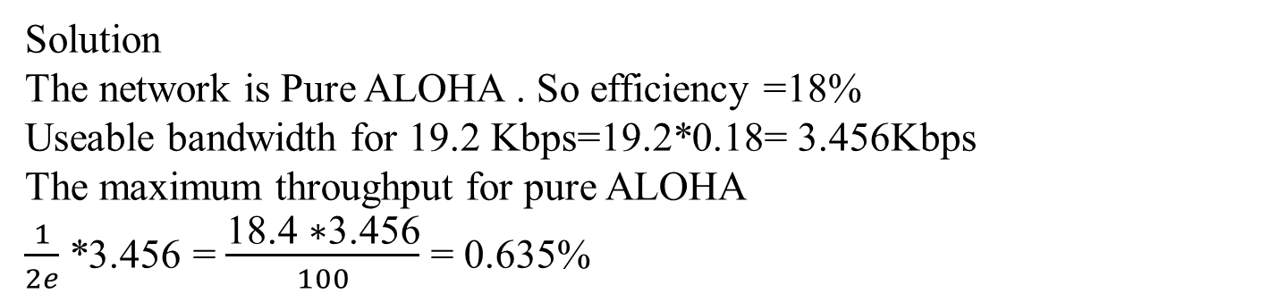
Questions
An ALOHA network uses 19.2Kbps channel for sending message packets of 100 bits long size. Calculate the maximum throughput for Pure ALOHA network.
Solution
The network is Pure ALOHA . So efficiency =18%
Useable bandwidth for 19.2 Kbps=19.2*0.18= 3.456Kbps
The maximum throughput for pure ALOHA
$\frac{1}{2e}$ *3.456 = $\frac{\text{18.4 ∗3.456}}{100}$ = 0.635%

Slide 85
Questions
b. If the system creates 500 frames per second, this is (1/2) frame per millisecond. The load is (1/2). In this case
S = G × e^{−G} or S = 0.303 (30.3 percent). This means that the throughput is 500 × 0.0303 = 151. Only 151 frames out of 500 will probably survive.
c. If the system creates 250 frames per second, this is (1/4) frame per millisecond. The load is (1/4).
case S = G × e ^{−G} or S = 0.195 (19.5 percent). This means that the throughput is 250 × 0.195 = 49. Only 49 frames out of 250 will probably survive.

Slide 86
Questions
A network using CSMA/CD has a bandwidth of 10 Mbps. If the maximum propagation time (including the delays in the devices and ignoring the time needed to send a jamming signal, as we see later) is 25.6 μs, what is the minimum size of the frame?
Solution
The frame transmission time is T_{fr} = 2 × T_{p} = 51.2 μs. This means, in the worst case, a station needs to transmit for a period of 51.2 μs to detect the collision. The minimum size of the frame is 10 Mbps × 51.2 μs = 512 bits or 64 bytes. This is actually the minimum size of the frame for Standard Ethernet.

Slide 87

Slotted Aloha
1. What is the advantage of Pure Aloha over Slotted Aloha?
Answer:
The advantage of pure aloha over slotted aloha is that there is no fixed size, and it has the ability to start transmission at any particular time and no need for synchronization.
2. What is the formula for Pure Aloha and Slotted Aloha?
Answer:
Pure Aloha: S = G x e^{-2G}
Slotted Aloha: S = G x e^{-G}

Slide 88
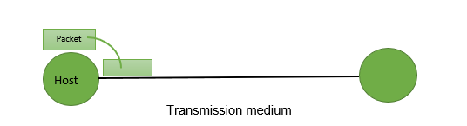
Delays in Computer Network
The delays, here, means the time for which the processing of a particular packet takes place. We have the following types of delays in computer networks:
1. Transmission Delay: The time taken to transmit a packet from the host to the transmission medium is called Transmission delay
For example, if bandwidth is 1 bps (every second 1 bit can be transmitted onto the transmission medium) and data size is 20 bits then what is the transmission delay? If in one second, 1 bit can be transmitted. To transmit 20 bits, 20 seconds would be required.
Let B bps is the bandwidth and L bit is the size of the data then transmission delay is,
Tt = L/B

Slide 89

Delays in Computer Network
2. Propagation delay:
After the packet is transmitted to the transmission medium, it has to go through the medium to reach the destination. Hence the time taken by the last bit of the packet to reach the destination is called propagation delay.
Factors affecting propagation delay:
Distance – It takes more time to reach the destination if the distance of the medium is longer.
Velocity – If the velocity(speed) of the medium is higher, the packet will be received faster.
Tp = Distance / Velocity

Slide 90
Delays in Computer Network
3. Queueing delay: Let the packet is received by the destination, the packet will not be processed by the destination immediately. It has to wait in a queue in something called a buffer. So the amount of time it waits in queue before being processed is called queueing delay.
In general, we can’t calculate queueing delay because we don’t have any formula for that.
4. Processing delay: Now the packet will be taken for the processing which is called processing delay.
Time is taken to process the data packet by the processor that is the time required by intermediate routers to decide where to forward the packet, update TTL, perform header checksum calculations.
It also doesn’t have any formula since it depends upon the speed of the processor and the speed of the processor varies from computer to computer.

Slide 91
Protocols
Data Link Protocols
Noiseless Channels
Noisy Channels
Simplex
Stop – and – wait
Stop – and – wait ARQ
Go-Back- N ARQ
Selective Repeat ARQ

Slide 92
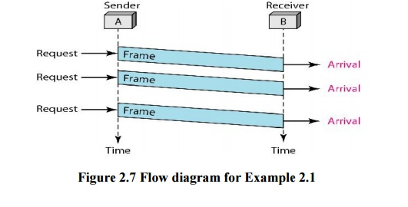
For Noiseless channels
Simplex Protocol
unidirectional data transmission over an ideal channel
It has distinct procedures for sender and receiver.
The sender simply sends all its data available onto the channel as soon as they are available its buffer.
The receiver is assumed to process all incoming data instantly.

Slide 93
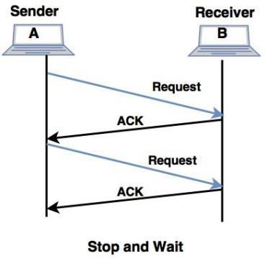
For Noiseless channels
Stop – and – Wait Protocol
unidirectional data transmission without any error control facilities
flow control so that a fast sender does not drown a slow receiver.
The receiver has a finite buffer size with finite processing speed.
The sender can send a frame only when it has received indication from the receiver that it is available for further data processing.

Slide 94
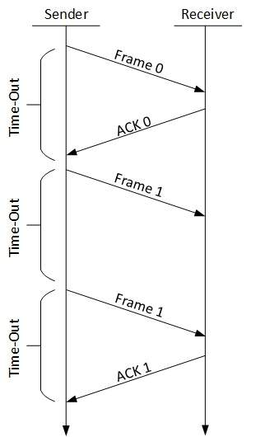
For Noisy Channels
Stop – and – Wait ARQ (Automatic Repeat Request)
with added error control mechanisms
The sender keeps a copy of the sent frame.
It then waits for a finite time to receive a positive acknowledgement from receiver.
If the timer expires or a negative acknowledgement is received, the frame is retransmitted.
If a positive acknowledgement is received then the next frame is sent.

Slide 95
For Noisy Channels
Go – Back – N ARQ
sending multiple frames before receiving the acknowledgement for the first frame.
It uses the concept of sliding window, and so is also called sliding window protocol.
The frames are sequentially numbered and a finite number of frames are sent.
If the acknowledgement of a frame is not received within the time period, all frames starting from that frame are retransmitted.
Reason for retransmission
Damaged frame
Lost data frame
Lost Acknowledgement

Slide 96
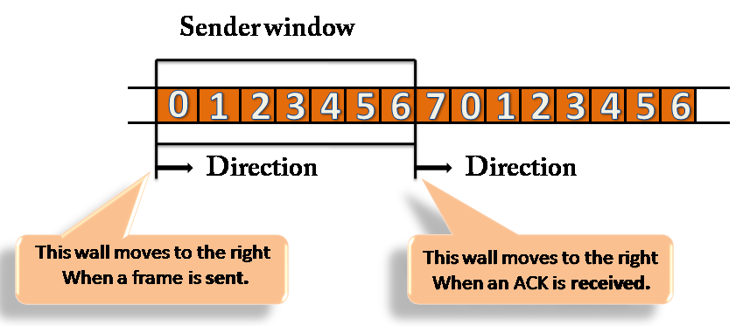
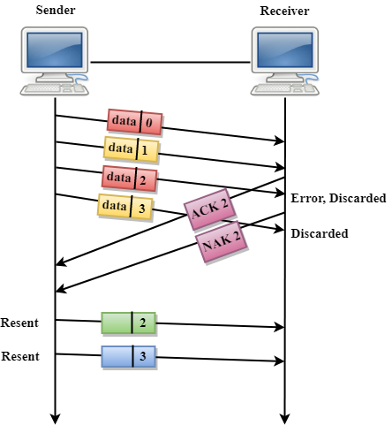
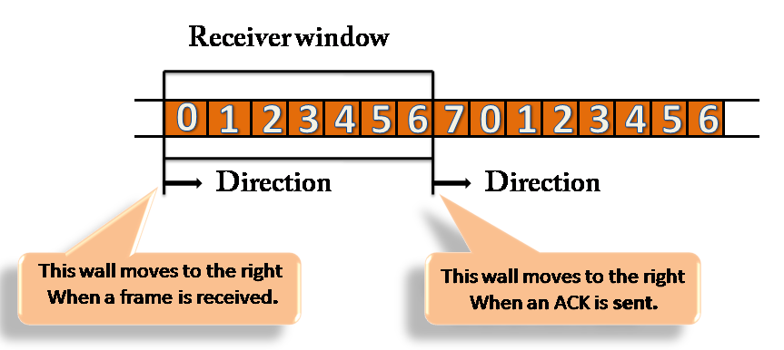
For Noisy Channels
Go – Back – N ARQ

Slide 97
For Noisy Channels
Piggy backing Technique
there is a need for transmitting data in both directions between 2 computers.
A full duplex circuit is required for the operation.
the data frames and ACK (control) frames in the reverse direction have to be interleaved.
An efficient method is to absorb the ACK frame into the header of the data frame going in the same direction. This technique is known as piggybacking.
When a data frame arrives at an IMP (receiver or station), instead of immediately sending a separate ACK frame, the IMP restrains itself and waits until the host passes it the next message.
The acknowledgement is then attached to the outgoing data frame using the ACK field in the frame header.

Slide 98
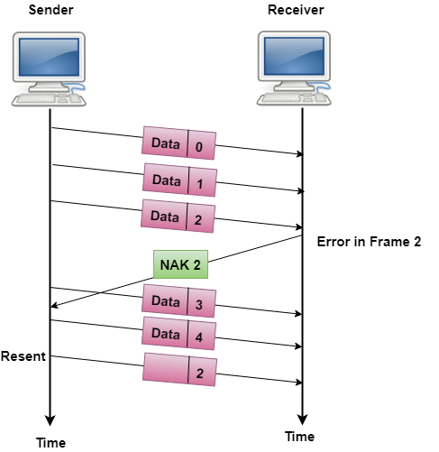
For Noisy Channels
Selective Repeat ARQ
sending multiple frames before receiving the acknowledgement for the first frame.
only the erroneous or lost frames are retransmitted, while the good frames are received and buffered.

Slide 99
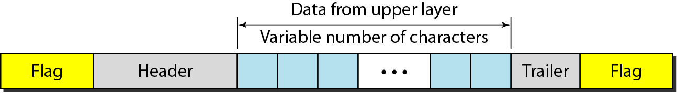
Data Link Layer
The data link layer needs to pack bits into frames, so that each frame is distinguishable from another.
The three main functions of the data link layer are
to deal with transmission errors,
regulate the flow of data, and
provide a well-defined interface to the network layer
Design issues -Error Control
Dealing with transmission errors.
Sending acknowledgement frames in reliable connections.
Retransmitting lost frames.
Identifying duplicate frames and deleting them.
Controlling access to shared channels in case of broadcasting.

Slide 100
Error detection and correction
To detect errors, a common technique is to introduce redundancy bits that provide additional information. Various techniques for error detection include::
Simple Parity Check
Two-dimensional Parity Check
Checksum
Cyclic Redundancy Check (CRC)
Simple Parity Check
Simple-bit parity is a simple error detection method that involves adding an extra bit to a data transmission. It works as:
1 is added to the block if it contains an odd number of 1’s, and
0 is added if it contains an even number of 1’s

Slide 101
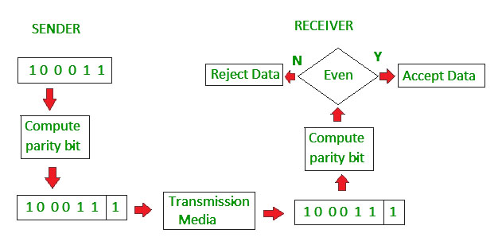
Error detection and correction

Slide 102
Error detection and correction
Disadvantages
Single Parity check is not able to detect even no. of bit error.
For example, the Data to be transmitted is 101010. Codeword transmitted to the receiver is 1010101 (we have used even parity).
Let’s assume that during transmission, two of the bits of code word flipped to 1111101.
On receiving the code word, the receiver finds the no. of ones to be even and hence no error, which is a wrong assumption.

Slide 103
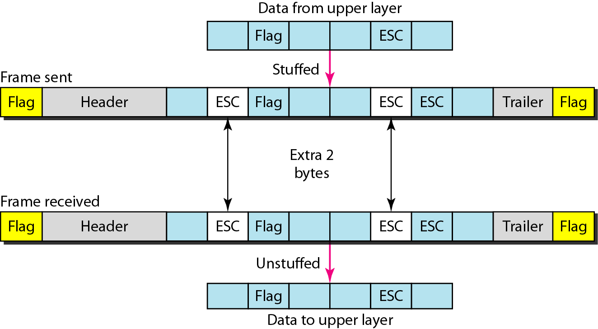
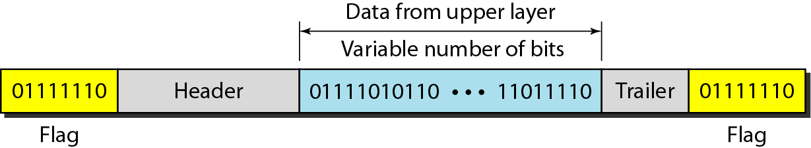
Byte stuffing & bit stuffing

Slide 104
Error Control
Error control
Error Detection
Error Correction
Parity hamming distance
Checksum
CRC

Slide 105
Error Detection(CO5)
Parity checks
For a data of n size add a parity bit
Even parity
Odd parity
For example if a data to be send is 1110001
Then for even parity the bit will be 0
for odd parity the bit will be 1
How many bit errors it can detect?
Suppose 10001110 is transmitted received as 10011110 -------error detected
But if 10001110 is transmitted received as 10010110 --------no error detected

Slide 106
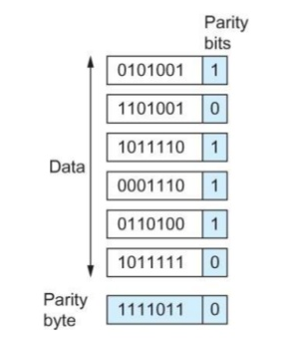
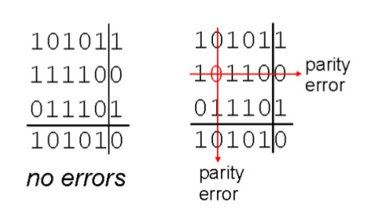
Error Detection
Two dimensional parity checks

Slide 107
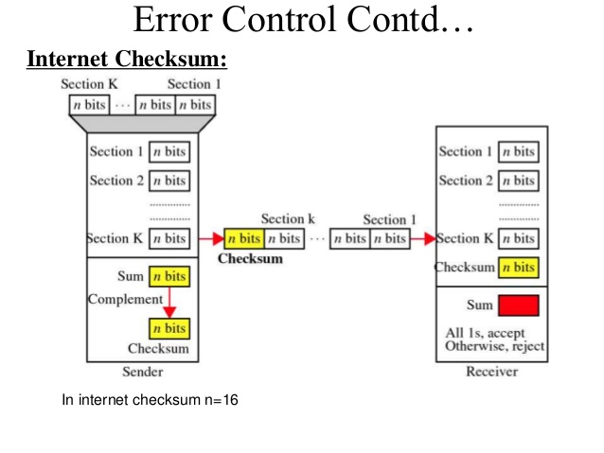
Error Detection
Checksum

Slide 108
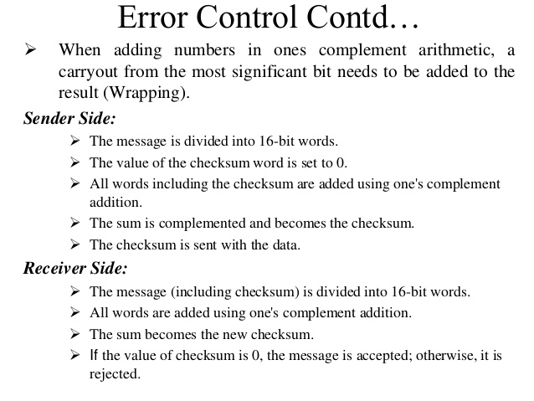
Error Detection
Checksum

Slide 109
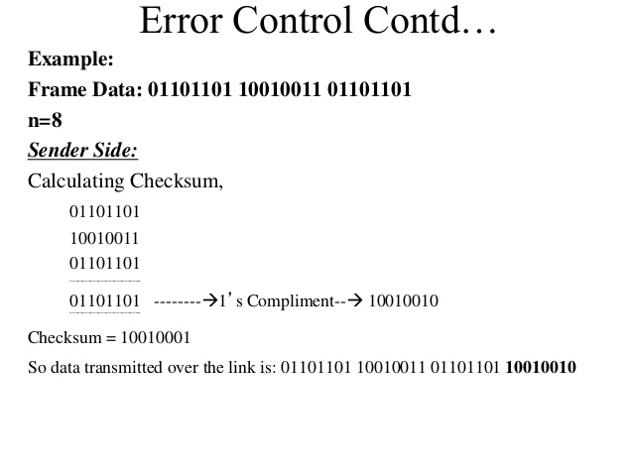
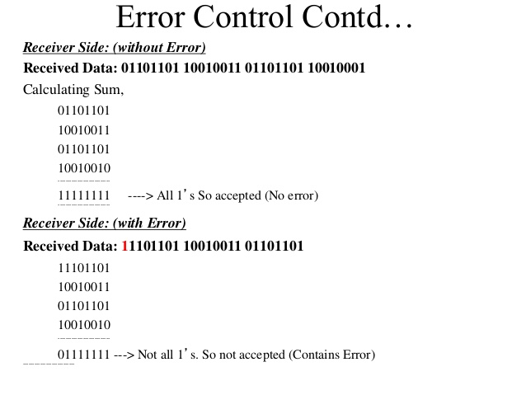
Error Detection
Checksum

Slide 110
Error Detection
Cyclic Redundancy check (CRC)
Packet of data transmitted as a polynomial 1101 = x^3+x^2+1
At sender end - the polynomial is divided by the given generating polynomial
Remainder is attached to the end of the message
Quotient is discarded
Message is transmitted
Receiver divides the message with same polynomial
If remainder not equal to zero then error occurred
Else equal to zero then no error

Slide 111
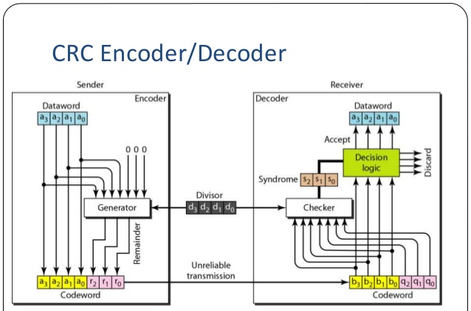
Error Detection

Slide 112
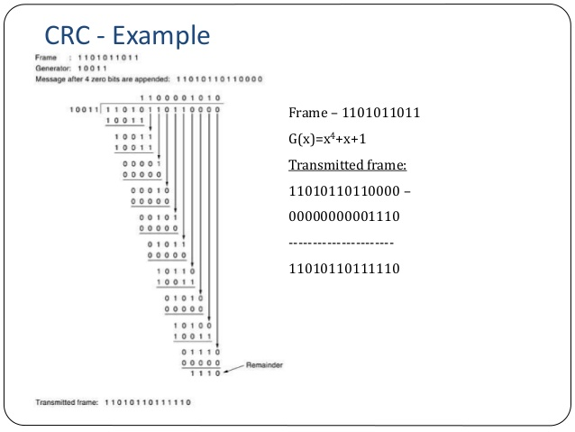
Error Detection
K= 11010110110000
N= 10011
C = k+n-1 =14
Remainder = 1110
11010110110000
1110
Codeword =11010110111110
N = 10011

Slide 113
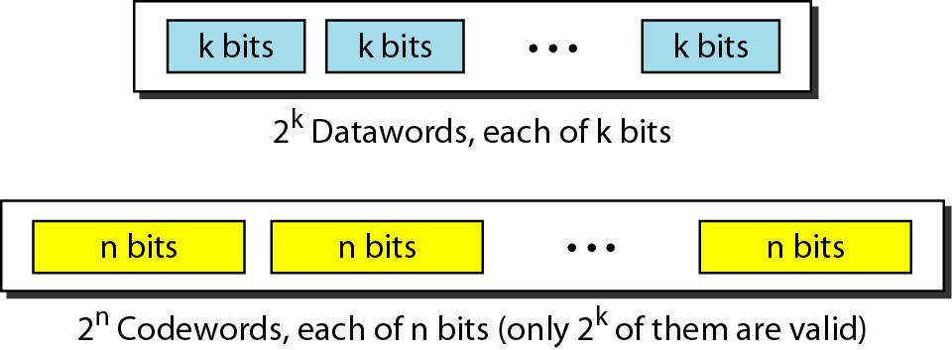
Error Correction
Block coding
In block coding, we divide our message into blocks, each of k bits, called datawords.
We add r redundant bits to each block to make the length n = k + r.
The resulting n-bit blocks are called codewords.

Slide 114
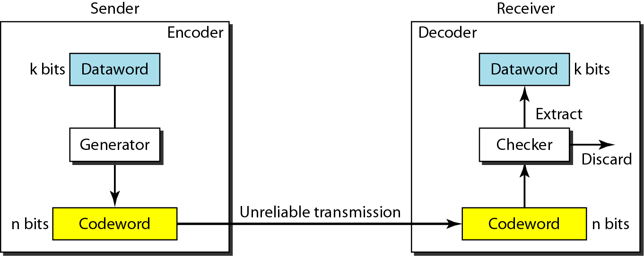
Error Correction
Block coding

Slide 115
Error Correction
Hamming distance
The Hamming distance between two words is the number of differences between corresponding bits.
The minimum Hamming distance is the smallest Hamming distance between all possible pairs in a set of words.
To guarantee the detection of up to s errors in all cases, the minimum Hamming distance in a block code must be d_{min} = s + 1.
To guarantee correction of up to t errors in all cases, the minimum Hamming distance in a block code must be d_{min} = 2t + 1.

Slide 116
Error Correction
Hamming distance
The Hamming distance d(000,011) is 2
000 XOR 011 is 011
Similarly for designing a code minimum hamming distance is used
Which is the smallest hamming distance between all possible pairs
Ex 1. For d(000,011)=2 d(000,101) =2 d(000,110) =2 d(011,101)=2
d(011,110) =2 d(101,110)=2
Ex. For d(00000,01011)= 3 d(00000,10101) =3 d(00000,11110)=4
Error detected =3
Error corrected =2

Slide 117
Error Detection and correction : hamming code

Slide 118
Error Detection and correction : hamming code
Hamming Code

Slide 119
Error Detection and correction : hamming code

Slide 120
Error Detection and correction : hamming code
Example of Hamming Code

Slide 121
Error Detection: CRC
Error Detection and correction : hamming code
Error Detection and correction : hamming code
Single-bit error

Slide 122
Error Detection and correction : hamming code
Error
Detection

Slide 123
IEEE Standards
Topic objective
Understand the IEEE standards
Various standard designed for IEEE
Recap of previous topic
What are protocols?
Protocols used for data link layer
Implement error detection and correction code

Slide 124
IEEE Standards(CO2)
In 1985 The Computer society started a project called Project 802
Enable intercommunication among various devices
Specify functions of physical layer and data link layer of LAN protocols
Various IEEE 802 standards are as
IEEE 802.1 High Level Interface
IEEE 802.2 Logical Link Control(LLC)
IEEE 802.3 Ethernet
IEEE 802.4 Token Bus
IEEE 802.5 Token Ring
IEEE 802.6 Metropolitan Area Networks
IEEE 802.7 Broadband LANs
IEEE 802.8 Fiber Optic LANS
IEEE 802.9 Integrated Data and Voice Network
IEEE 802.10 Security
IEEE 802.11 Wireless Network

Slide 125
IEEE Standards
802.2 Logical Link Control
"the standard for the upper Data Link Layer sublayer also known as the Logical Link Control layer. It is used with the 802.3, 802.4, and 802.5 standards (lower DL sublayers).“
specifies the general interface between the network layer (IP, IPX, etc) and the data link layer (Ethernet, Token Ring, etc).
It is responsible for flow and error control.

Slide 126
IEEE Standards
802.3 Ethernet
standard for CSMA/CD (Carrier Sense Multiple Access with Collision Detection).
This standard encompasses both the MAC and Physical Layer standards. If there is no data, any node may attempt to transmit, if the nodes detect a collision, both stop transmitting and wait a random amount of time before retransmitting the data.
The original 802.3 standard is 10 Mbps (Megabits per second). 802.3u defined the 100 Mbps (Fast Ethernet) standard, 802.3z/802.3ab defined 1000 Mbps Gigabit Ethernet, and 802.3ae define 10 Gigabit Ethernet.
Commonly, Ethernet networks transmit data in packets, or small bits of information.
A packet can be a minimum size of 72 bytes or a maximum of 1518 bytes.

Slide 127
IEEE Standards
802.4 Token Bus
Token bus standards as broadband computer networks
Logically, the stations are organized into a ring
When the logical ring is initialized, the highest numbered station may send the first frame. The token and frames of data are passed from one station to another following the numeric sequence of the station addresses.
The token does not follow the physical ordering of workstation attachment to the cable,there is no collision as only one station possesses a token at any given time.

Slide 128
IEEE Standards
802.5 Token Ring
designed to use the ring topology and utilizes a token to control the transmission of data on the network.
The token is a special frame which is designed to travel from node to node around the ring. When it does not have any data attached to it, a node on the network can modify the frame, attach its data and transmit. Each node on the network checks the token as it passes to see if the data is intended for that node, if it is; it accepts the data and transmits a new token. If it is not intended for that node, it retransmits the token on to the next node.

Slide 129
IEEE Standard
FDDI (Fiber Distributed Data Interface)
a set of ANSI and ISO standards for data transmission on fiber optic lines in a local area network (LAN) that can extend in range up to 200 km (124 miles). The FDDI protocol is based on the token ring protocol
An FDDI network contains two token rings, one for possible backup in case the primary ring fails.

Slide 130
IEEE Standard
The FDDI data frame format is:
Where
PA is the preamble,
SD is a start delimiter,
FC is frame control,
DA is the destination address, SA is the source address,
PDU is the protocol data unit (or packet data unit),
FCS is the frame check Sequence (or checksum), and
ED/FS are the end delimiter and frame status.
PA | SD | FC | DA | SA | PDU | FCS | ED/FS
16 bits | 8 bits | 8 bits | 48 bits | 48 bits | up to 4478×8 bits | 32 bits | 16 bits

Slide 131
IEEE Standards
802.11 Wireless Network Standards
collection of standards setup for wireless networking.
the three popular standards: 802.11a, 802.11b, 802.11g and latest one is 802.11n.
Each standard uses a frequency to connect to the network and has a defined upper limit for data transfer speeds.
802.11a was one of the first wireless standards.
802.11b standard was popular due to higher prices and lower range.
802.11g is a standard operates in the same band as 802.11b, 802.11g is compatible with 802.11b equipment.
Wireless LANs primarily use CSMA/CA - Carrier Sense Multiple Access/Collision Avoidance. It has a "listen before talk" method of minimizing collisions on the wireless network.
This results in less need for retransmitting data.

Slide 132
Faculty Video Links, Youtube & NPTEL Video Links and Online Courses Details
Youtube /other Video Links
https://www.youtube.com/watch?v=JFF2vJaN0Cw&list=PLxCzCOWd7aiGFBD2-2joCpWOLUrDLvVV_
https://www.youtube.com/watch?v=yNedVgNyE8Q

Slide 133
Daily Quiz
Let G(x) be the generator polynomial used for CRC checking. What is the condition that should be satisfied by G(x) to detect odd number of bits in error?
(A) G(x) contains more than two terms (B) G(x) does not divide 1+x^k, for any k not exceeding the frame length (C) 1+x is a factor of G(x) (D) G(x) has an odd number of terms.
2. Data link layer deal with data in the form of –
a. Bit b. Packet c. Frame d. Segment
3. In Bit stuffing we insert-------- after 00000.
a. 1 b. 0 c. 00 d. 11

Slide 134
Weekly Assignment
Daily Quiz
4. In Ethernet when Manchester encoding is used, the bit rate is:
(A) Half the baud rate. (B) Twice the baud rate. (C) Same as the baud rate. (D) None of the above
5. Which of the following is a MAC address? (A) 192.166.200.50 (B) 00056A:01A01A5CCA7FF60 (C) 568, Airport Road (D) 01:A5:BB:A7:FF:60
Pure and Slotted term related to which type of protocol-
a. CSMA b. ALOHA c. Token ring d. FDDI
7. IEEE 802.5 related to protocol-
a. Internetworking b. Ethernet c. Token ring d. Token Bus
8. IEEE 802.3 related to protocol-
a. Internetworking b. Ethernet c. Token ring d. Token Bus
9. Which combination is correct for IPv6 and IPv4 –
a. 48 & 32 b. 32 & 48 c. 128 & 48 d. 128 & 32
10.CRC method is –
a. Error Detection b. Error Correction c. Both d. None of above

Slide 135
Weekly Assignment
1. Name the functions of Data link layer (CO2)
2. Name the error control methods at data link layer. (CO2)
3. Explain the need of flow control. (CO2)
4. Calculate the frame transmission time for the frame length 30 bytes at the speed of 10Mbps. (CO2)
5. Name the IEEE standards for LAN.(CO2)
6. DQDB and FDDI standards.(CO2)
7. Explain the format of token in token ring topology. (CO2)
8. Explain the need of bit stuffing. (CO2)
9. find the checksum for the given data 1010000111001010(CO2)
20. Write the efficiency of pure aloha and slotted aloha protocol(CO2)
11. Calculate CRC code for given data 10011000 with given divisor x3+x2+1(CO2)
12. Calculate hamming code for the given 7 bit data 1101101. (CO2)

Slide 136
MCQ s
1.Sliding window ARQ generally implemented in (CO2)
Go-Back-N ARQ
Go-Reject-N ARQ
Selective reject ARQ
A &C
2. HDLC is an acronym for _______. (CO2)
High-duplex line communication
High-level data link control
Half-duplex digital link combination
Host double-level circuit

Slide 137
MCQ s
Which among the following represents the objectives/requirements of Data Link Layer? (CO2) a. Frame Synchronization b. Error & Flow Control c. Both a & b d. None of the above
4. Which feature of Go-Back-N ARQ mechanism possesses an ability to assign the sliding window in the forward direction? (CO2) a. Control Variables b. Sender Sliding Window c. Receiver Sliding Window d. Resending of frames

Slide 138
Old Question Papers

Slide 139
Old Question Papers
Old Question Papers

Slide 140
Expected Questions for University Exam
Compare CSMA, CSMA/CD and CSMA/CA (CO3)
Measurements of a pure aloha channel with a infinite no. of users show that 12% of the slots are idle. (CO3)
a) What is the offered load (G)
b) What is the throughput(S)
c) Is channel overload or under load.

Slide 141
Summary
In this unit we have discussed functions of data link layer and how the data is represent at data link layer using data link layer protocols.
How header is attached to the data received by network layer and error is detected and corrected at receiver site as well as flow control is managed so that receiver will not be overflow by data.

Slide 142
Recap of Unit
Functions of data link layer
Sub layers of data link layer
Project 802
PDU format,MAC frame
IEEE LAN standards
Ethernet
Token Ring
FDDI
DQDB
Data Link Layer Protocols
Multiple Access Protocol
Flow control
Error control

Slide 143
References
Books:
Forouzen, "Data Communication and Networking",TMH
A.S. Tanenbaum, Computer Networks, Pearson Education
W. Stallings, Data and Computer Communication, MacmillanPress
Thank You

